Slide 1

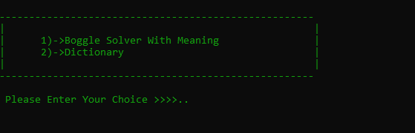
DSA-II Boggle solver + Dictionary USING TRIE DATA STRUCTURE
NAME : RIDDHI GANESH THAREWAL
DIV 1
MIS : 111903068

Slide 2
Trie data structure
TRIE IS DIGITAL TREE OR PREFIX TREE WHICH STORES STRINGS THAT CAN BE VISUALIZED AS GRAPH.
A trie is tree-like data structure whose nodes in a particular way,words and strings can be retrieved from the structure by traversing down a branch path of tree.
APPLICATION:
It can be used to make dictionary with meanings.
It can be used to make search in phonebook Directory.
Autocomplete Suggestion.
Boggle Word game
Etc……

Slide 3
Continue….
In trie data structure the struct node contain Array pointer of size 26 and int data type to indicate if the word ends,char pointer for meaning.
In these I am going to implement dictionary by storing the meaning where the word ends .
I will Also try to implement related suggestion as while searching.
At the Same time the Boggle Solver is also implemented.

Slide 4
Continue…..
Function to be implemented:
Initialization of trie/create trie
Loading data from file into trie
Adding word into file
Insertion of data/information
Searching operation.
Autosuggesting
Deleting /Destroying the loaded trie
Boggle solver
Linked list for solving boggle.
Also will try to explore…
Data Structure used:
Trie used to create Dictionary
File Handling which is required for loading words and meaning from text file and also to add word into file.
Linked list to Traverse The Path in boggle .
An array structure is used which will be required for avoiding the revisit to same location again.

Slide 5
Timeline
Firstly I have performed Dictionary with meaning where I required 2 weeks.
Then in next week I researched on boggle that how is that solved and all .
Then in next week I implemented linked list file.
Then after Array to avoid revisiting and main function.

Slide 6
Time Complexiety
Dictionary:
Insert function O(n)……. Where n is length of word
Delete O(1)
Add word O(n) ….n is length of word
Load Dictionary : O(n)
Destroy : O(n*m) ……..where n is length of words and m is total words
Delete word: O(n)………where n is length of word
Display O(n) ……….where n is length of word
Linked list:
Insertion:O(1) for one character
Removenode:O(n)
Deletion:O(n)
Get : O(1)
Boggle:
Load boggle:O(n) ….n is number of element to be inserted

Slide 7
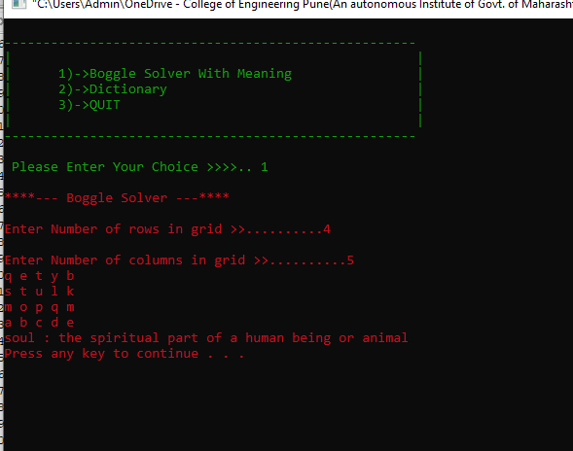
Boggle Solver

Slide 8
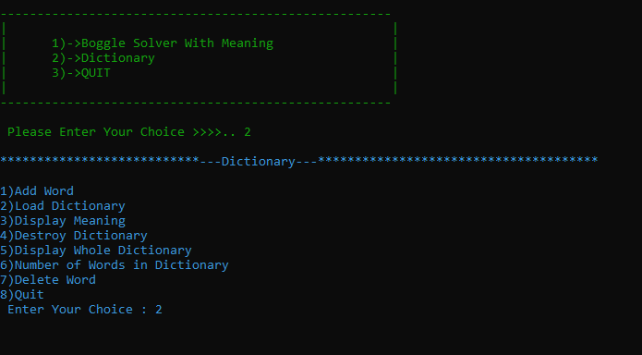
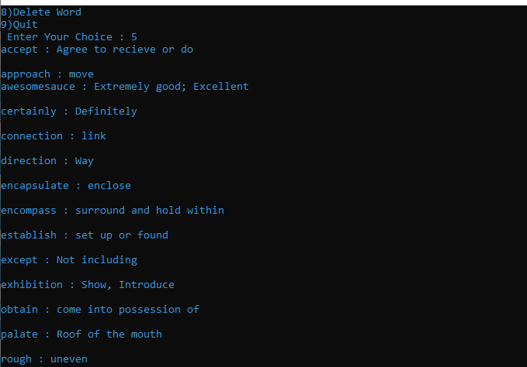
Dictionary

